Slide 1

Maximum likelihood Estimate
Dr. Linrui Zhang
University of Central Missouri

Slide 2
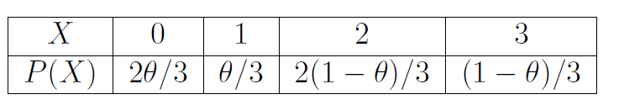
Examples 1
Suppose that X is a discrete random variable with the following probability mass function: where 0<θ<1 is a parameter.
The following 10 independent observations were taken from such a distribution: (3, 0, 2, 1, 3, 2, 1, 0, 2, 1). What is the maximum likelihood estimate of θ.

Slide 3
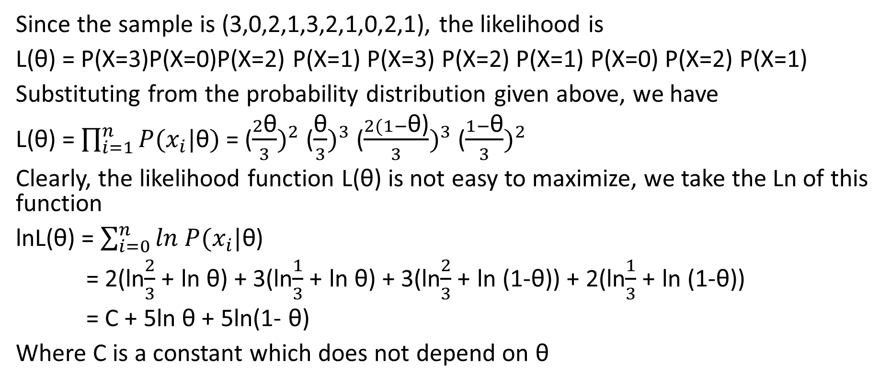
Solution
Since the sample is (3,0,2,1,3,2,1,0,2,1), the likelihood is
L(θ) = P(X=3)P(X=0)P(X=2) P(X=1) P(X=3) P(X=2) P(X=1) P(X=0) P(X=2) P(X=1)
Substituting from the probability distribution given above, we have
L(θ) = $\prod_{i=1}^{n}{P(x_{i}|\text{θ})}$ = ($\frac{2\text{θ}}{3})^{2}$ ($\frac{\text{θ}}{3})^{3}$ ($\frac{2(1−\text{θ}\text{)}}{3})^{3}$ ($\frac{1−\text{θ}}{3})^{2}$
Clearly, the likelihood function L(θ) is not easy to maximize, we take the Ln of this function
lnL(θ) = $\sum_{i=0}^{n}{ln}$ $P(x_{i}|\text{θ}$)
= 2(ln$\frac{2}{3}$+ ln $\text{θ}$) + 3(ln$\frac{1}{3}$+ ln $\text{θ}$) + 3(ln$\frac{2}{3}$+ ln (1-$\text{θ}\text{)}$) + 2(ln$\frac{1}{3}$+ ln (1-$\text{θ}\text{)}$)
= C + 5ln $\text{θ}$ + 5ln(1- $\text{θ}$)
Where C is a constant which does not depend on θ

Slide 4

Solution
Let the derivative of L(θ) with respect to θ be zero
$\frac{dl(\text{θ})}{d\text{θ}}$ = $\frac{5}{\text{θ}}$ - $\frac{5}{\text{1−}\text{θ}}$ = 0
And the solution fives us the MLE, which is $\hat{\text{θ}}$ = 0.5.

Slide 5
Example 2
A unfair coin is flipped 100 times, and 61 heads are observed. What is the MLE when nothing is previously known about the coin?

Slide 6
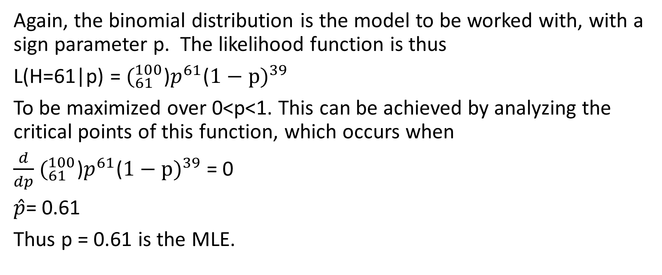
Solution
Again, the binomial distribution is the model to be worked with, with a sign parameter p. The likelihood function is thus
L(H=61|p) = $(_{61}^{100}$)$p^{61}$($1−p)^{39}$
To be maximized over 0<p<1. This can be achieved by analyzing the critical points of this function, which occurs when
$\frac{d}{dp}$ $(_{61}^{100}$)$p^{61}$($1−p)^{39}$ = 0
$\hat{p}$= 0.61
Thus p = 0.61 is the MLE.

Slide 7
Example 3 -- Homework
Suppose that X is a discrete random variable with the following probability mass function: where 0<θ<1 is a parameter.
The following 10 independent observations were taken from such a distribution: (3, 1, 3, 0, 3, 1, 2, 3). What is the maximum likelihood estimate of θ.
X | 0 | 1 | 2 | 3
P(X) | θ² | 2θ(1-θ) | θ² | 1-2θ

Slide 8
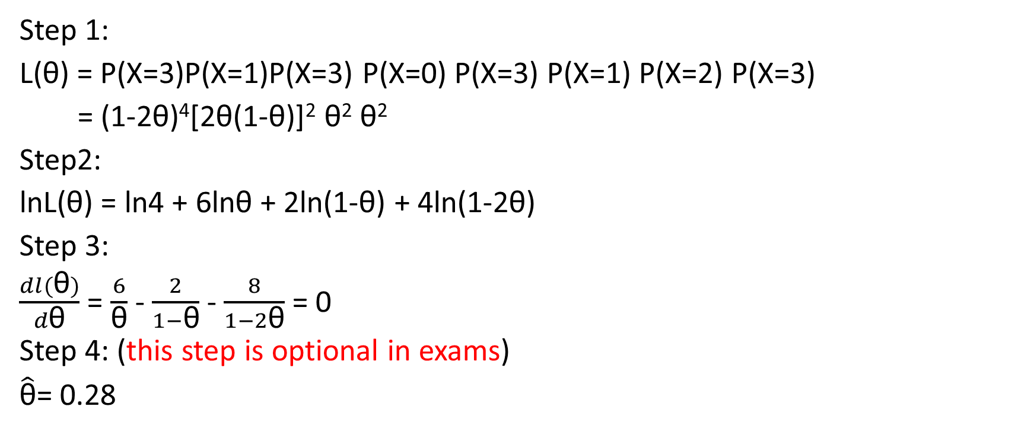
Solution
Step 1:
L(θ) = P(X=3)P(X=1)P(X=3) P(X=0) P(X=3) P(X=1) P(X=2) P(X=3)
= (1-2θ)⁴[2θ(1-θ)]² θ² θ²
Step2:
lnL(θ) = ln4 + 6lnθ + 2ln(1-θ) + 4ln(1-2θ)
Step 3:
$\frac{dl(\text{θ})}{d\text{θ}}$ = $\frac{6}{\text{θ}}$ - $\frac{2}{1−\text{θ}}$ - $\frac{8}{1−2\text{θ}}$ = 0
Step 4: (this step is optional in exams)
$\hat{\text{θ}}$= 0.28

